Slide 1
Quantum Risk Scoring
Predicting Financial Volatility using Variational Quantum Circuits & Random Forests
Aleksander Kwaśnioch, Karol Niemczuk, Paweł Rudnik

Slide 2
Agenda
Problem Definition: Predicting Future Realized Volatility (21-Day Horizon).
Data Strategy: The "Global" Dataset (Top 100 Tickers).
Feature Engineering: The power of 90-Day Trends.
The Bottleneck: Compressing 1301 Features to 8 Qubits.
Models: Classical Benchmark (Random Forest) & Quantum Classifier (VQC).
Summary

Slide 3

The Problem – Predicting Risk
The Goal: Predict the Future Realized Volatility over the next 21 Days (1 Trading Month).
Classification:
Low Risk
Medium Risk
High Risk
Very High Risk

Slide 4

Project Scope: The Quantum Simulation
Research Objective: Exploration of Quantum Machine Learning (QML) capabilities in financial risk classification
Execution Environment: PennyLane Simulator
Environment: 8-Qubit device

Slide 5

Data acquisition
Source: Yahoo Finance API (yfinance)
Universe: Top 100 US Companies by Market Cap + S&P 500
Scope: 5 Years of historical data
Features: 1301 Technical Indicators generated per timestamp.

Slide 6
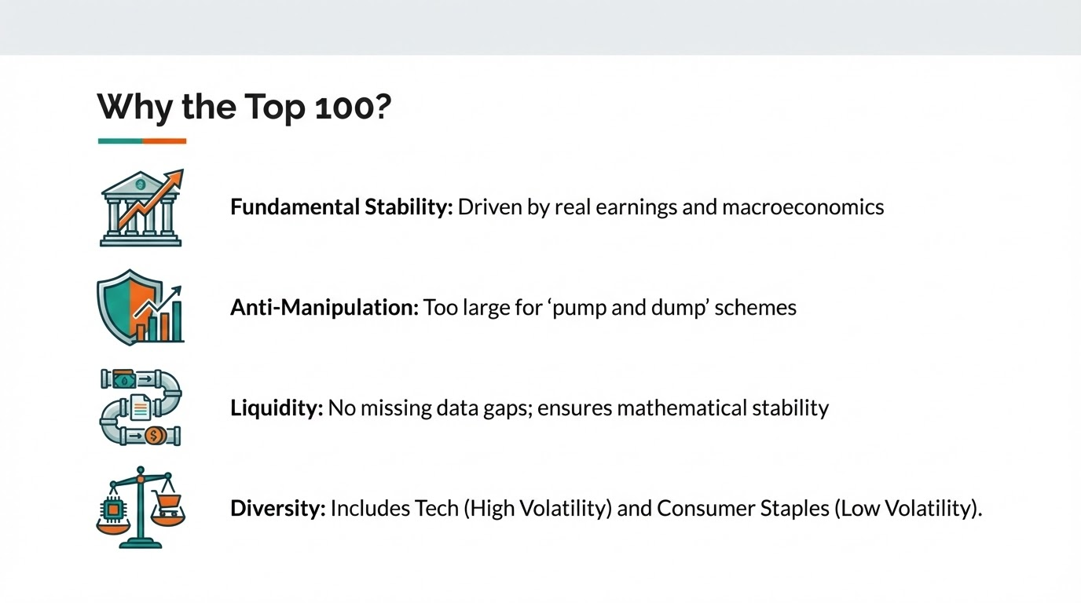

Slide 7
Data Preprocessing
Process: For each of the 100 tickers, we calculated 13 specific technical indicators daily
The indicators:
Short-Term:
a) Log Returns - A measure of price change calculated as the natural logarithm of the ratio of the final price to the initial price
b) RSI - A momentum oscillator that measures the speed and change of price movements to identify overbought or oversold conditions in an asset.
c) Volume Change - An indicator that reflects the percentage or absolute change in trading volume compared to a previous period
d) 20-day Volatility -A statistical measure of the dispersion of returns over the last 20 trading days, representing the asset's short-term risk and price fluctuations.
e) SMA 20 Ratio - The ratio of the current price to its 20-day Simple Moving Average, used to determine how far the price has deviated from its short-term mean.
f) Relative Return - The difference between the return of a specific asset and the return of a benchmark or market index over the same period.
g) Market Correlation - A coefficient that measures how closely an asset's price moves in relation to the broader market or a specific reference index.

Slide 8
Data Preprocessing
The indicators:
Medium-Term (Quarterly):
90-day Volatility - The annualized standard deviation of daily returns over the last 90 days, reflecting the medium-term price stability or risk level of the asset.
90-day Return - The total percentage change in the asset's price over the last 90 days, representing the absolute performance over a full trading quarter.
90-day Maximum Drawdown - The measure of the largest peak-to-trough decline in price during the last 90 days, indicating the worst-case loss scenario a holder could have experienced in that window.
SMA 50 Ratio - The ratio between the current price and its 50-day Simple Moving Average, used to identify if an asset is currently overextended or undervalued relative to its medium-term trend.
Structure:
Bollinger_Pct (%B) - A metric that quantifies where the current price sits relative to the bands, where 1.0 is the upper band, 0.0 is the lower band, and values above or below indicate the price is "trading outside the bands."
Bollinger_Width - A measure of the distance between the upper and lower bands, which identifies periods of high volatility or extreme "squeezes" that often precede major price breakouts.
Total dimension: ( 100 Tickers * 13 Features) + 1 Market Index = 1301 Total Features

Slide 9
Classical Baseline (Random Forest)
Algorithm: Random Forest Classifier (Ensemble of Decision Trees)
Training Data: Trained on the full "Long" dataset, ~125k rows (no PCA compression needed).
Purpose: To set a performance benchmark and to analyze Feature Importance (explainability).
Why Random Forest?
Robust to Noise and Overfitting - By averaging multiple decision trees, the ensemble method mitigates the impact of market noise inherent in a 5-year dataset, providing more stable risk predictions than single estimators.
Optimal for Medium-Sized Datasets - Random Forest achieves high performance on limited 5-year timeframes without the computational cost or instability
Transparent Risk Drivers - Our model provides feature importance analysis offering clear interpretability on specific indicators

Slide 10
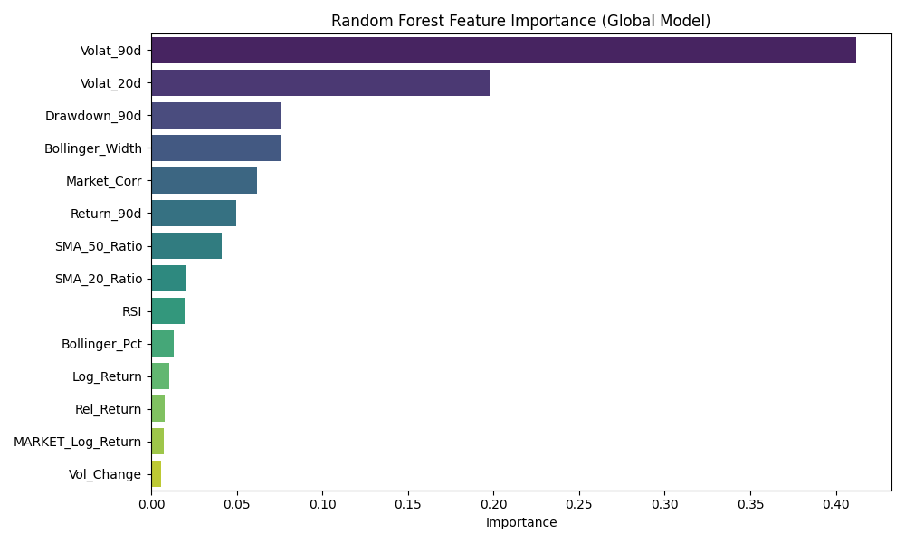
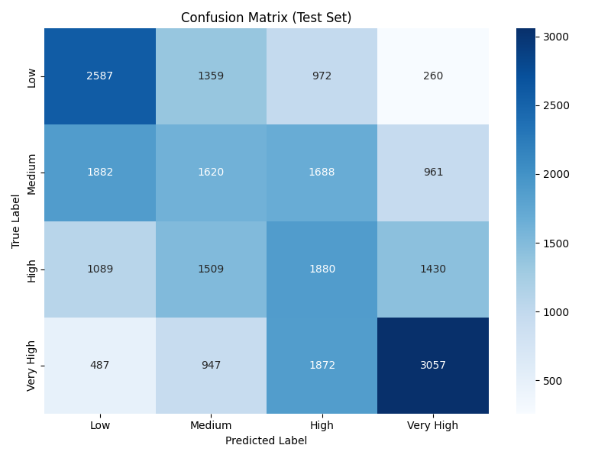
Random Forest

Slide 11
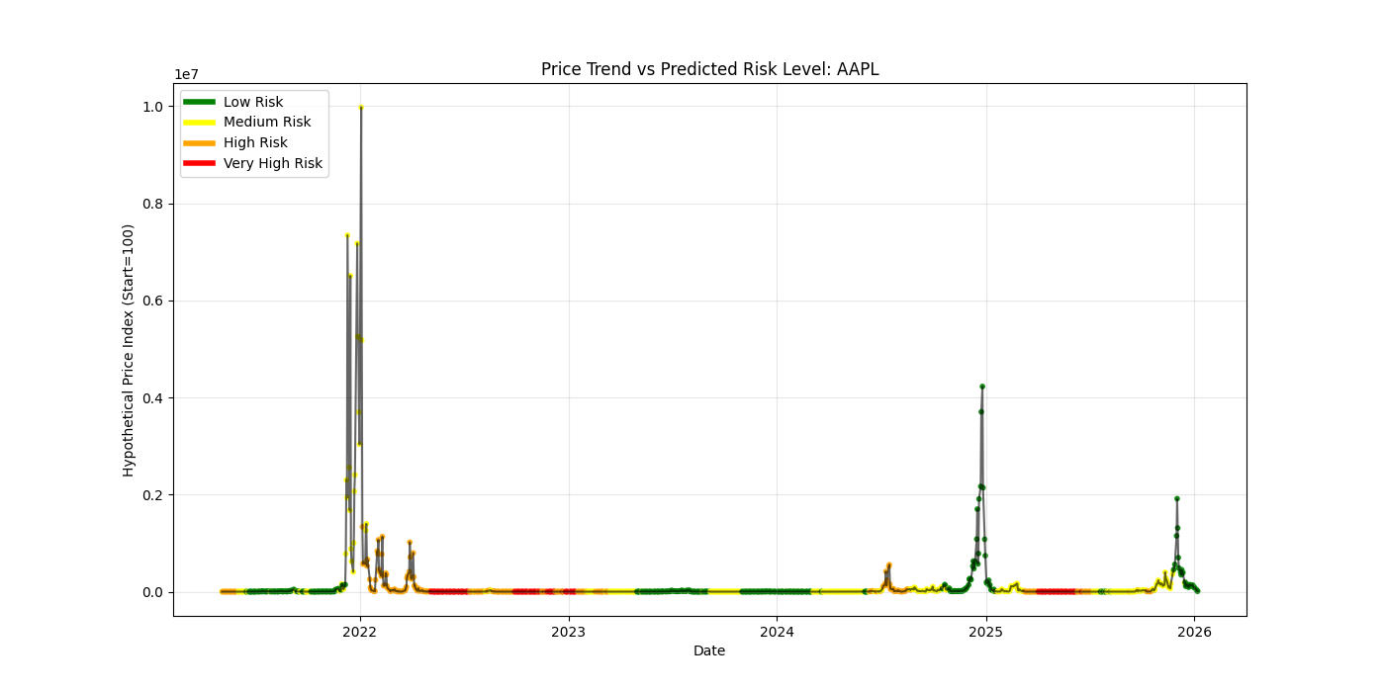
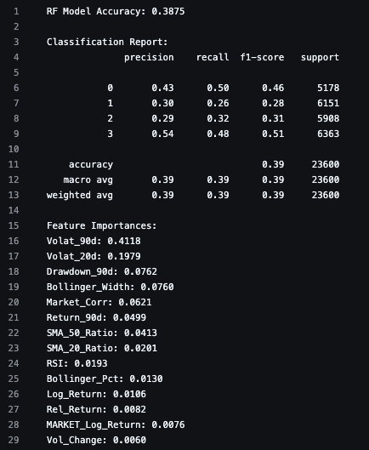
Random Forest

Slide 12
Variational Quantum Classifier (VQC)
Framework: PennyLane
Type: Hybrid Quantum-Classical Loop
Workflow:
State Preparation (Encoding Data)
Ansatz (Quantum Neural Network)
Measurement (Output)
Classical Optimizer (Update Weights)
Classical Data -> PCA -> Quantum Circuit -> Measurement -> Optimizer -> New Weights.

Slide 13
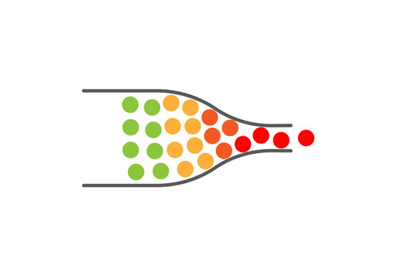
The engineering challenge for quantum
The problem:
Input 1301 Features ( High dimensionality)
Hardware 8 qubits (We are simulating 8 qubits device)
Mapping 1301 features directly to 8 qubits is inefficient and noisy

Slide 14
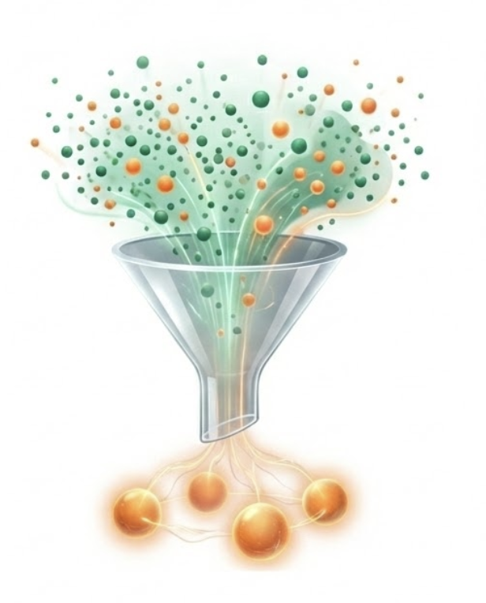
The Solution: PCA
Method: Principal Component Analysis (PCA)
Compression: 1301 Features → 8 Principal Components
Encoding: Components scaled to <0, π> (Radians)
Result: The "Essence" of the market state compressed into 8 rotation angles

Slide 15
Variational Quantum Classifier (VQC)
Definition:
A VQC is a hybrid quantum-classical algorithm, analogous to a classical Neural Network.

Slide 16
How it works:
State Preparation: Classical data is encoded into a quantum state.
Parameterized Circuit (PQC): A series of quantum gates (Rotations + Entanglement) process the data. These gates have tunable parameters θ (theta), similar to weights in a neural network.
Measurement: We measure the quantum state to get a probability distribution.
Classical Optimization: A classical optimizer (e.g., Adam) updates the parameters θ (theta) to minimize the loss function.

Slide 17
8-Qubit Quantum Risk Model
Circuit Structure:
Width: 8 Qubits (Direct mapping: 1 PCA component -> 1 Qubit).
Depth: 3 Layers of repeated operations.

Slide 18
Step-by-Step Data Flow:
Data Encoding (Re-uploading):
  We use AngleEmbedding (Rotation X) to load the 8 PCA features into the qubits.
  Note: We use "Data Re-uploading," meaning we inject the data into every layer, not just the beginning. This increases the model's expressibility.
Trainable Layers:
  We use StronglyEntanglingLayers.
  This creates complex dependencies (entanglement) between all 8 qubits, allowing the model to learn non-linear market patterns.

Slide 19
3. Output (Measurement):
  We measure the probabilities of the first 2 qubits ( wires=[0, 1] ).
  This gives us a distribution over 4 basis states: |00>, |01>, |10>, |11>, corresponding to our 4 Risk Classes.

Slide 20
Optimization & Handling Imbalance
The Problem:
Financial data is imbalanced. "Medium Risk" is common, while "Very High Risk" or “Low Risk” is less frequent.
Standard models tend to ignore rare events to play it safe.

Slide 21
Our Solution: Weighted Cross-Entropy Loss
We assign a specific penalty weight to each class in the cost function:
  Low/Med Risk: Weight 1.0 (Standard penalty).
  High Risk: Weight 3.0 (3x penalty for missing this).
  Very High Risk: Weight 8.0 (8x penalty).
Effect: The model is forced to be aggressive in predicting high-risk scenarios.

Slide 22
Training Loop:
Optimizer: Adam (stepsize=0.02).
Model Checkpointing: We save the best performing model (highest validation accuracy) during the 60 epochs, preventing overfitting.

Slide 23
Challenges & Analysis of Results
Aggressive Dimensionality Reduction (Information Loss)
  The Bottleneck: We compressed 1301 market features down to just 8 Principal Components to fit our quantum hardware.
The "Safety" Bias
  Behavior: Despite the Weighted Loss function, the model often defaults to predicting the majority class ("Medium") or the safer "Low".
  Why? In high-noise environments, ML models tend to converge on the statistical mean to minimize the global error, rather than risking penalties on rare, extreme predictions (Mode Collapse).

Slide 24
3. Quantum "Expressibility" Limits
Hardware Constraints: We used an 8-qubit circuit with 3 layers. While advanced, this is still a low-depth circuit.
Effect: The model may lack the necessary "expressibility" (capacity) to map the highly complex, chaotic nature of the stock market. It behaves like a "weak learner" — better than random, but not powerful enough to capture deep market sentiment.

Slide 25
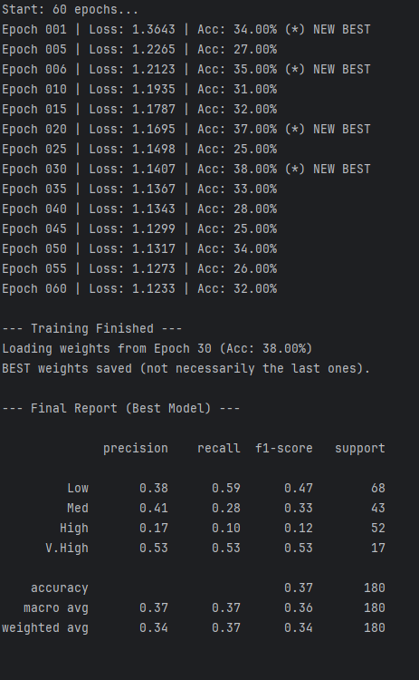

Slide 26
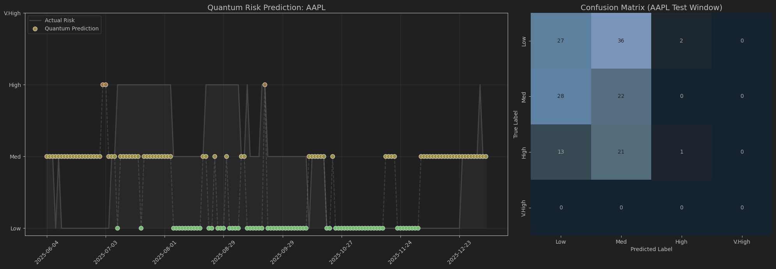

Slide 27
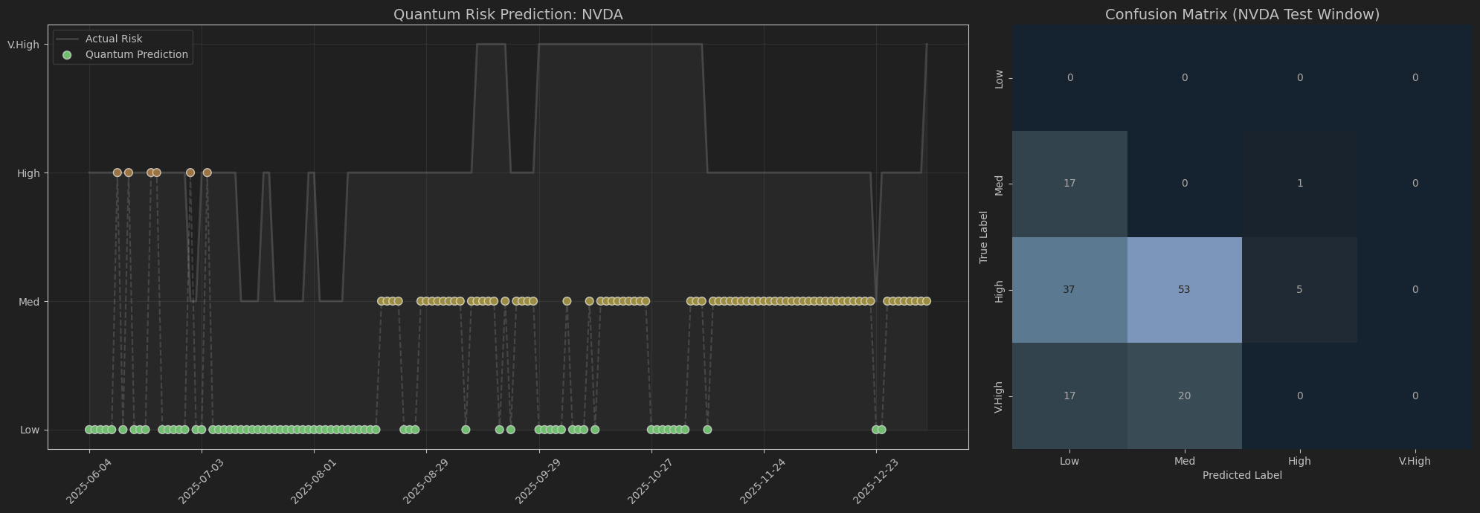

Slide 28
Conclusion & Future Work
Summary:
Engineered a massive 1,301-dimensional dataset
Identified 90-Day Volatility as the primary risk driver
Validated a Hybrid Quantum Pipeline (PCA + VQC)
Operating on a constrained 8-qubit architecture, the quantum solution already demonstrates strong alignment with real-world market volatility trends.
By mapping financial indicators into a high-dimensional quantum state, the model captures non-linear correlations that traditional classical models (XGBoost) may struggle to identify.
Future Steps:
Deploying circuits on Physical Quantum Processing Units via Amazon Braket or IBM Quantum.
Scale Up: Increase to bigger number of Qubits to reduce data loss.
LLM Agent: Add an AI to explain the risk score in plain English.

